Slide 1
Chapter 3
Brownian Motion
洪敏誠
2009/07/31
/23

Slide 2
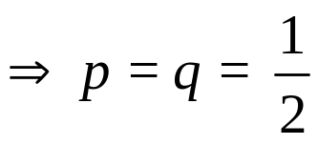
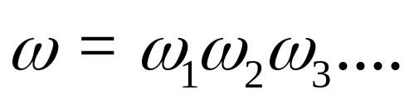
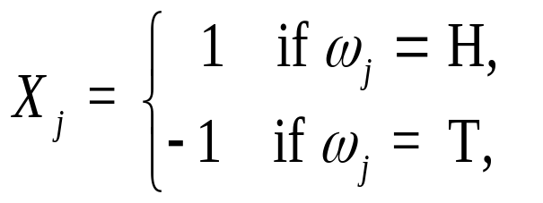
Symmetric Random Walk
p, the probability of H on each toss
q = 1 – p, the probability of T on each toss
Because the fair coin
Denote the successive outcomes of the tosses by
Let
/23

Slide 3
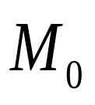
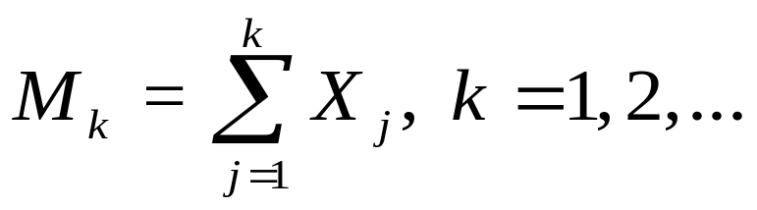
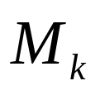
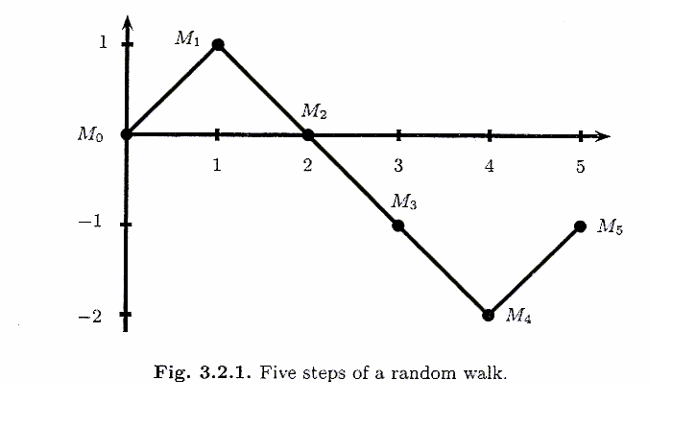
Define = 0,
The process , k = 0,1,2,…is a symmetric random walk
/23

Slide 4
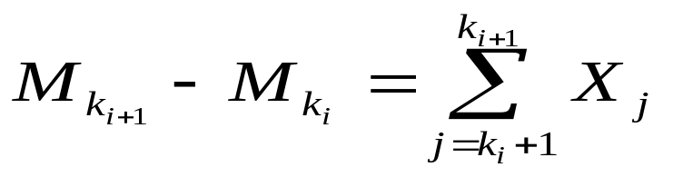
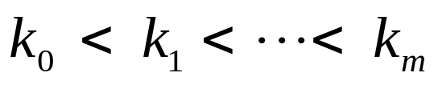
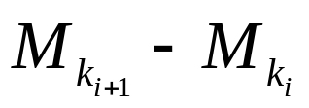
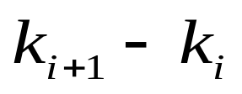
Increments of the Symmetric Random Walk
And
is called an increment of the random walk
A random walk has independent increments
．If we choose nonnegative integers
0 = , the random variables
are independent
Each increment has expected value 0 and variance
/23

Slide 5
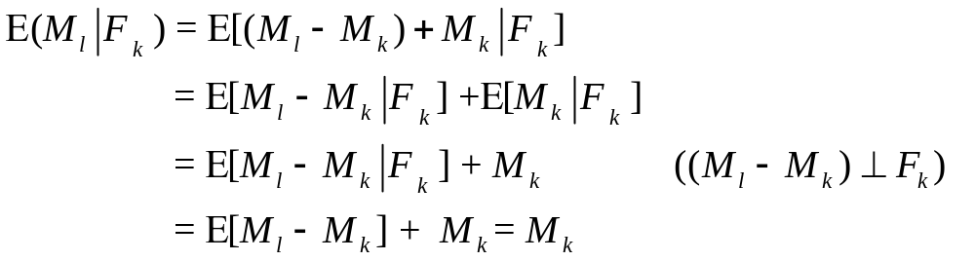
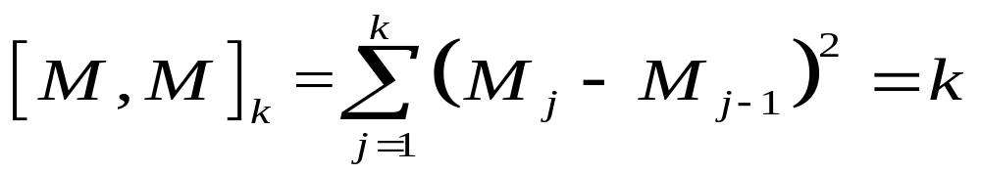
The symmetric random walk is a martingale
The quadratic variation is defined to be
/23

Slide 6
Log-Normal Distribution as the Limit of the Binomial Model
S₀u_{n}u_{n}
S₀u_{n}
S₀
S₀d_{n}u_{n}
S₀d_{n}
S₀d_{n}d_{n}
/23

Slide 7
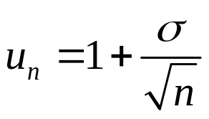
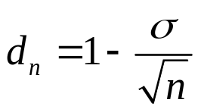

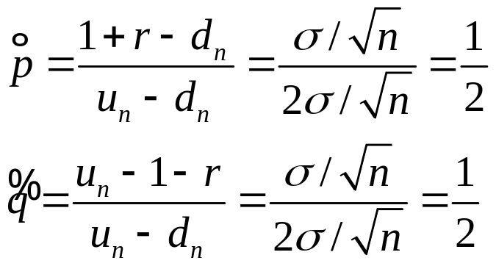
Let
  time interval from 0 to t
  n steps per unit time
  r=0
Up factor to be
Down factor to be
is a positive constant
The risk-neutral probability
/23

Slide 8


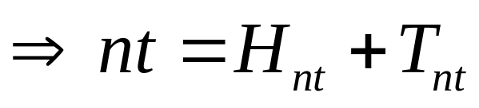

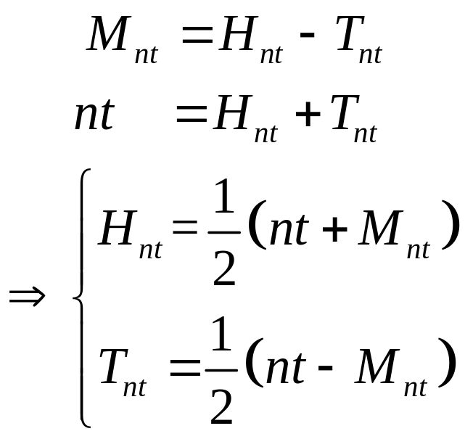
nt coin tosses
: the sum of the number of heads
: the sum of the number of tails
The random walk is the number of heads minus the number of tails
/23

Slide 9
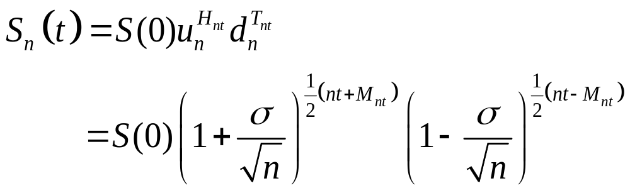
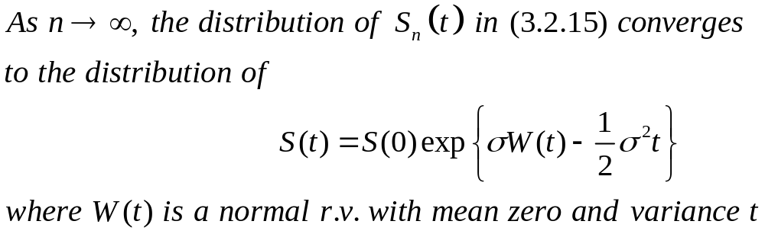
/23

Slide 10
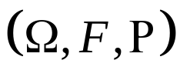

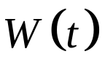

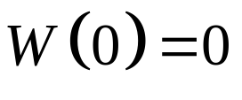

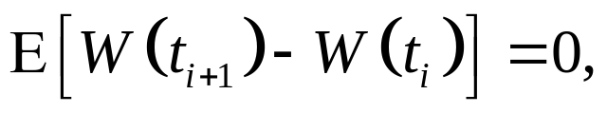
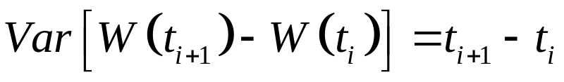
Definition of Brownian Motion
Definition 3.3.1
Let be a probability space. For each , suppose there is a continuous function of that satisfies
1.
2. for all the increments
are independent
3. each of these increments is normally distributed with
/23

Slide 11
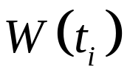
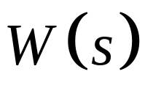
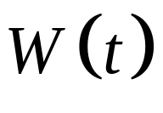
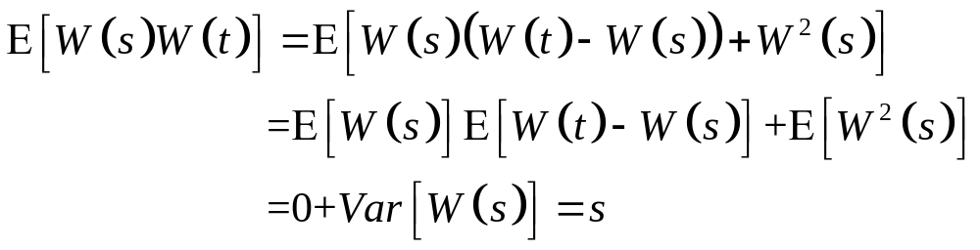
Distribution of Brownian Motion
1. has mean zero, i=1,…,m.
2. the covariance of and ：
, s < t
/23

Slide 12
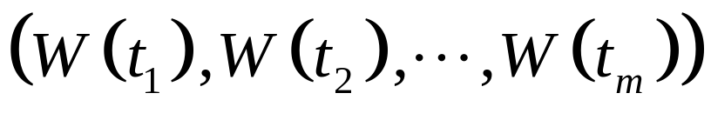
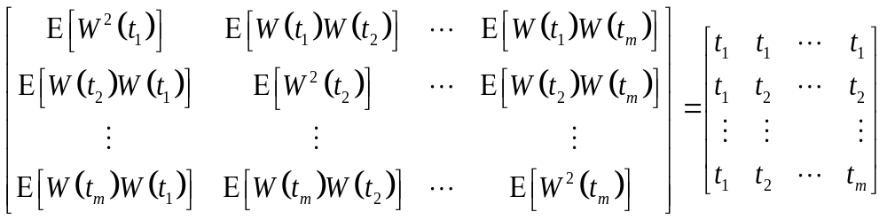
The covariance matrix for Brownian motion ( i.e., for the m-dimensional random vector
) is
/23

Slide 13
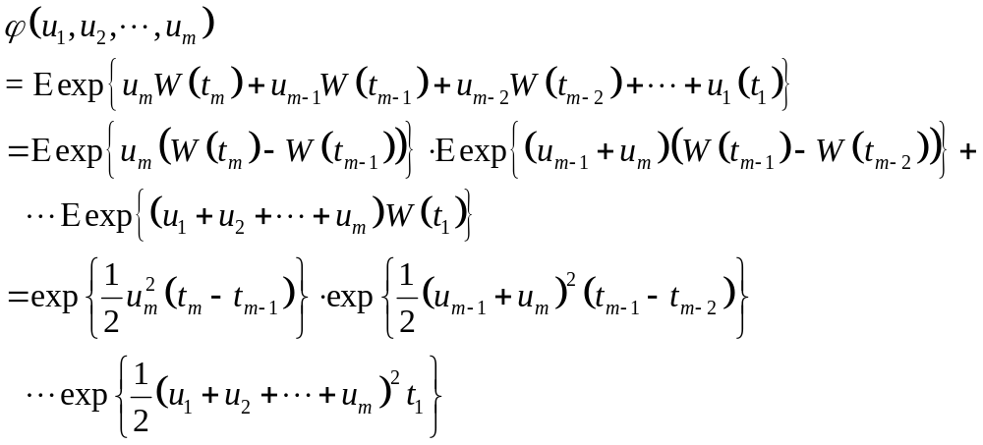
Joint moment-generating function
/23

Slide 14
Theorem 3.3.2 (Alternative characterizations of Brownian motion)
The following three properties are equivalent.
1.
  for all the increments
are independent
  each of these increments is normally distributed with
/23

Slide 15

For all , the random variables are jointly normally distributed with means equal to zero and covariance matrix.
For all , the random variables have the joint moment-generating function.
If any of 1, 2, or 3 holds ( and hence they all hold), then is a Brownian motion.
/23

Slide 16
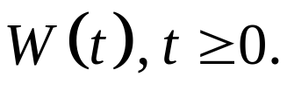











Definition 3.3.3 (Filtration for Brownian Motion)
Let be a probability space on which is defined a Brownian motion A filtration for the Brownian motion is a collection of -algebra satisfying：
( Information accumulates )
  For every set in is also in .
( Adaptivity )
  For each the Brownian motion at time t is -measurable.
( Independence of future increments )
  For the increment is independent of .
/23

Slide 17
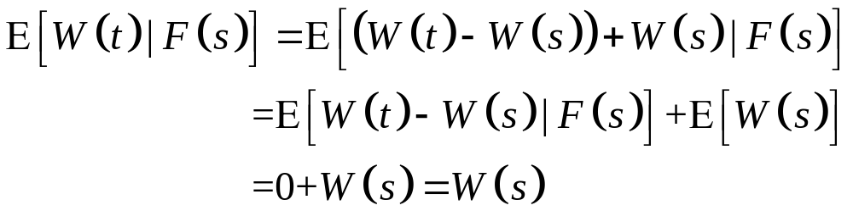
Theorem 3.3.4
Brownian motion is a martingale.
/23

Slide 18
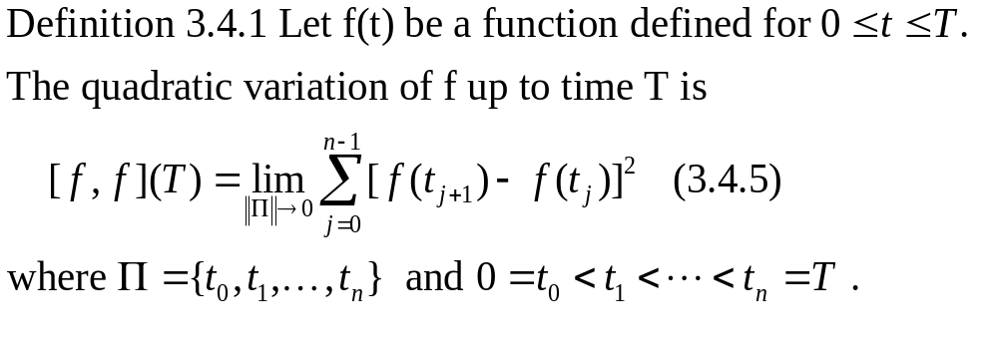
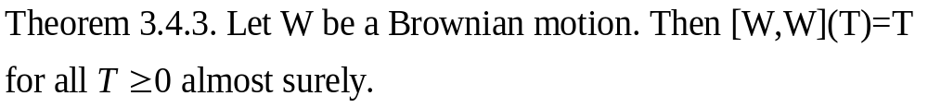
Quadratic Variation
/23

Slide 19
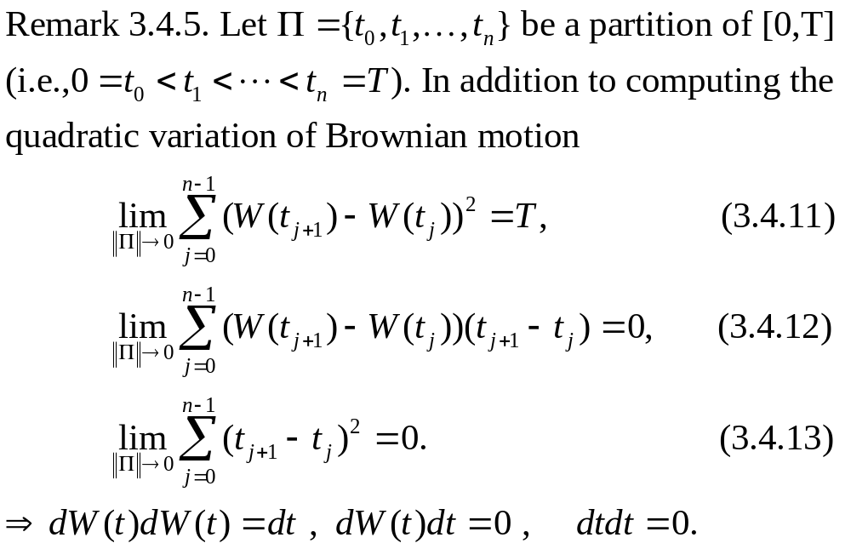
/23

Slide 20
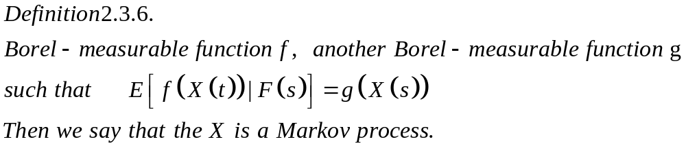
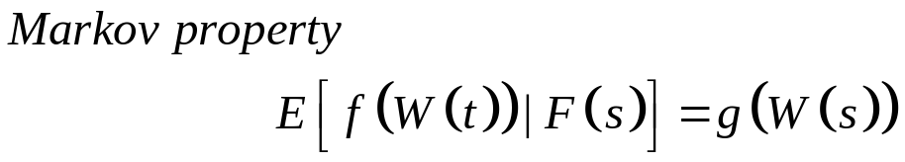



/23

Slide 21
First passage time
Let m be a real number, and define the first passage time to level m
τ_{m}=min{t≥0;W(t)=m}.
/23

Slide 22
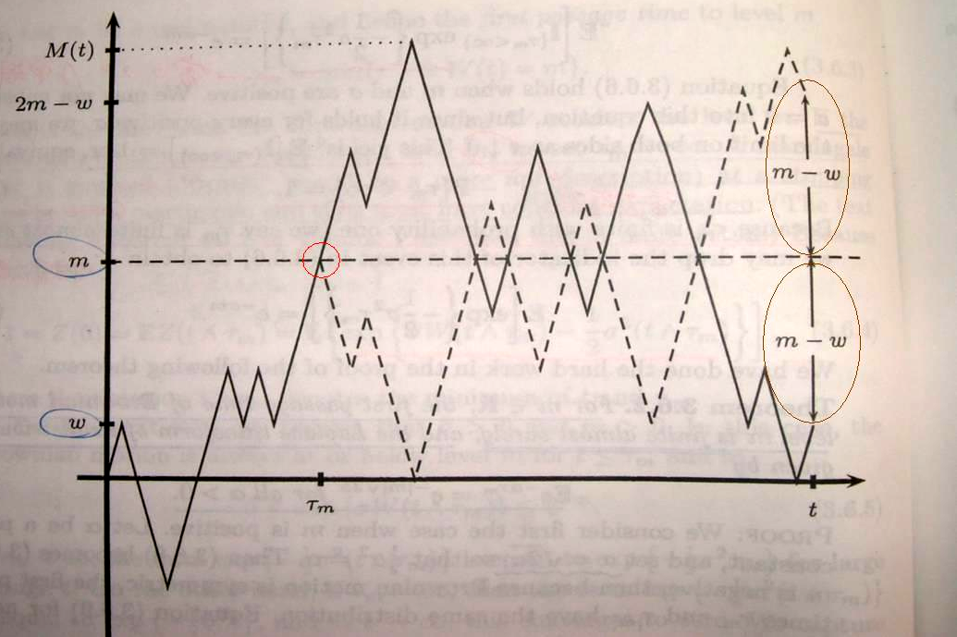
Reflection principle
/23

Slide 23
Summary:
1. BM 的定義 (Definition 3.3.1)，有三個條件需成立。 P10
2. BM的filtration (Definition 3.3.3)，有三個特性。 P16
3. BM是martingale。 P17
4. BM的quadratic variation 等於T。 P18
5. dW(t)dW(t)=dt dW(t)dt=0 dtdt=0。 P19
6. BM有Markov的性質。 P20
7. BM的reflection還是BM。 P22
/23

